Slide 1

Image Classification & Object Detection
Digital Egyptian Pioneers “DEPI” Round 3 Graduation Project

Slide 2
Introduction:
Existing tools are complex or slow.
Users need:
1. Easy-to-use interface
2. Quick predictions
3. High accuracy
4. No technical setup required

Slide 3
Project Goal:
Build a Streamlit web app that allows users to:
Classify the main object in an image & recognize multiple objects

Slide 4

Model Training
For this Project we used two models.
1. MobileNetV2 (Retrained & Applied fine-tuning techniques).
2. YOLO12X (Pretrained)

Slide 5
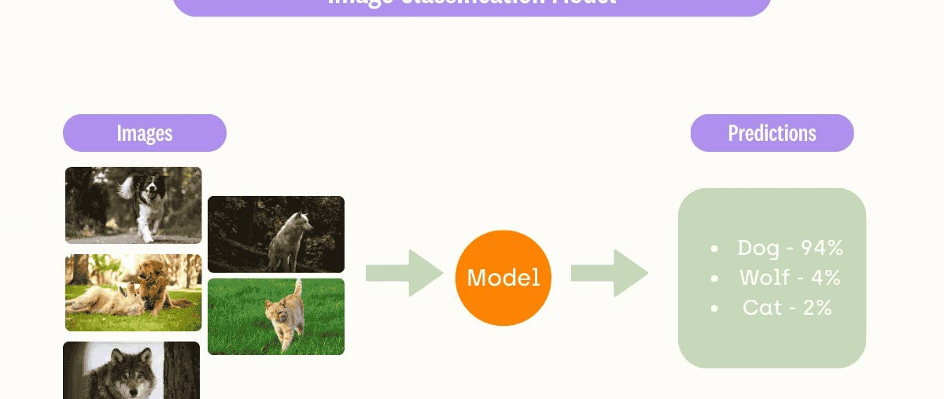
Classification Model
Explaining Classification Model from Architecture to training & predictions

Slide 6
Model Details:
Model Based on MobileNetV2.
Retrained using Transfer Learning (Unfroze the last 50 layers).
Dataset Used: CIFAR10.
Augmentations Applied on the Dataset:
Resizing to 224x224.
Random Flip Horizontal and Vertical.
Random Brightness.
Random Contrast.
Random Rotation.
Random Zoom.
Rescaling (1/255).

Slide 7
Model Details:
Model Based on MobileNetV2.
Retrained using Transfer Learning (Unfroze the last 50 layers).
Dataset Used: CIFAR10.
Training Cycle:
20 Epochs training cycle with Validation stages in-between for a total of 40 epochs (20 each).
Testing cycle.
Final Model Results:
- accuracy: 0.8451 - loss: 0.4446 - val_accuracy: 0.8404.

Slide 8
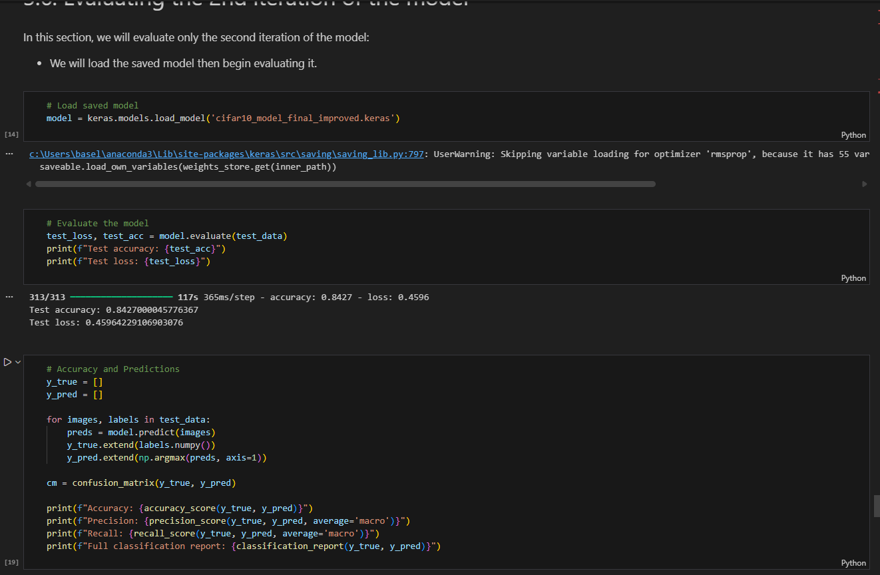
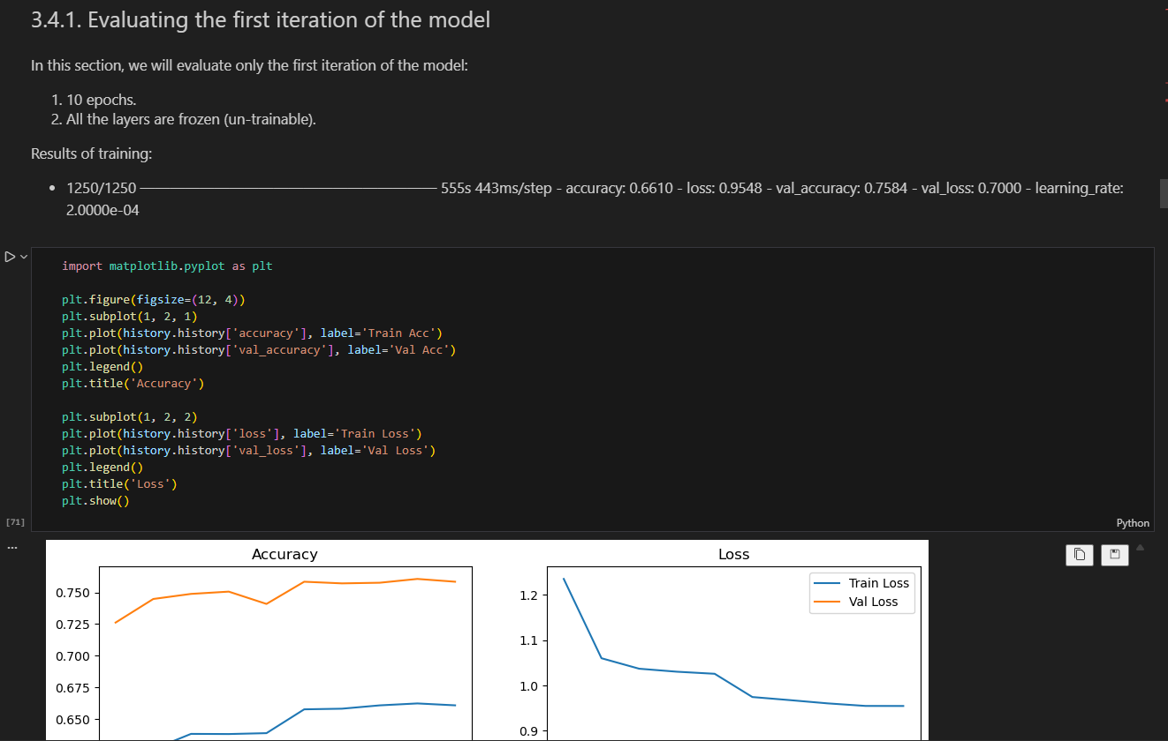
Model Training

Slide 9
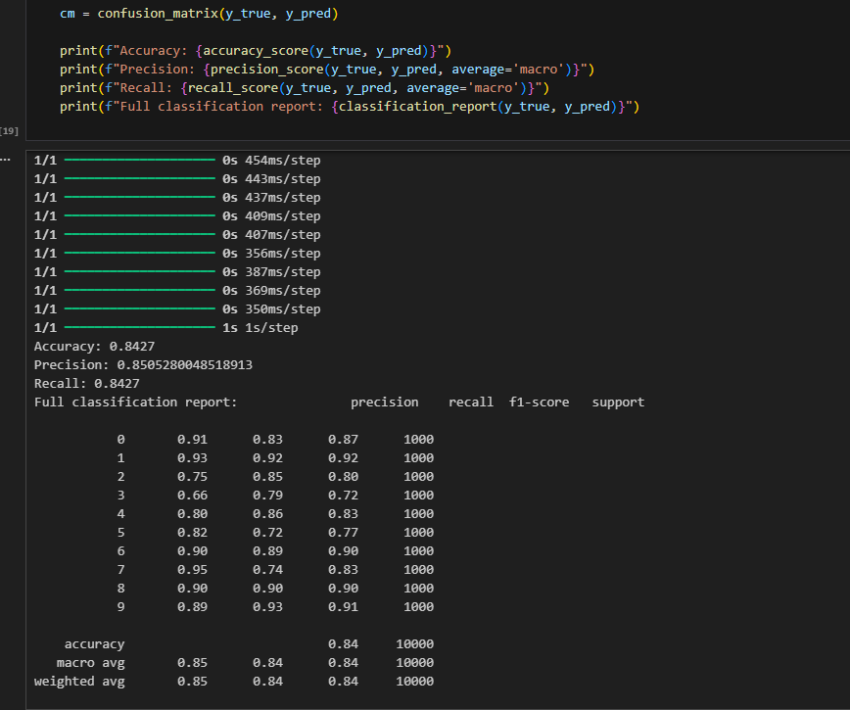
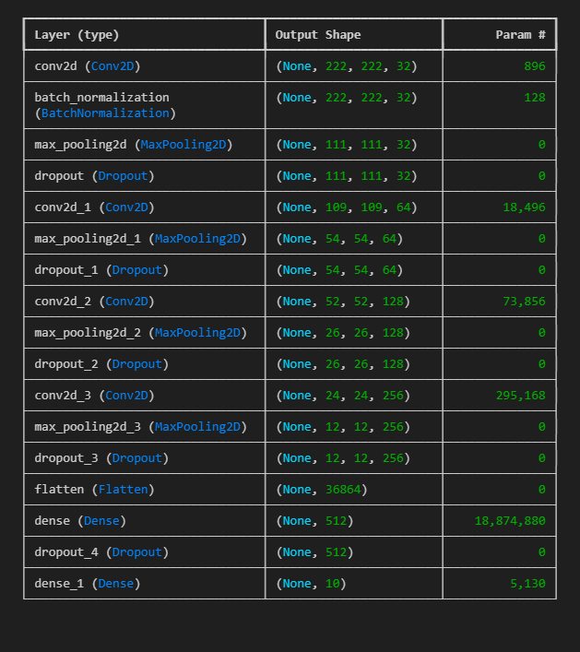
Model Training

Slide 10
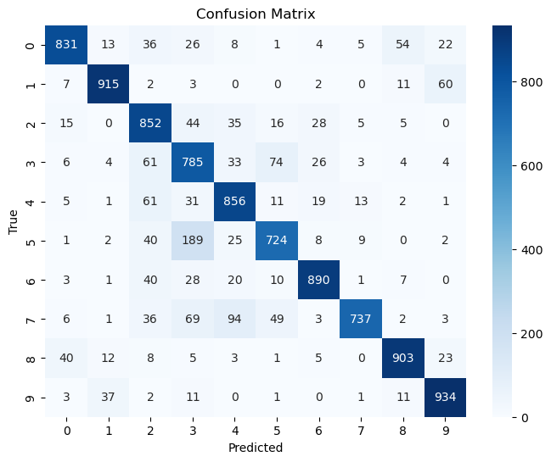
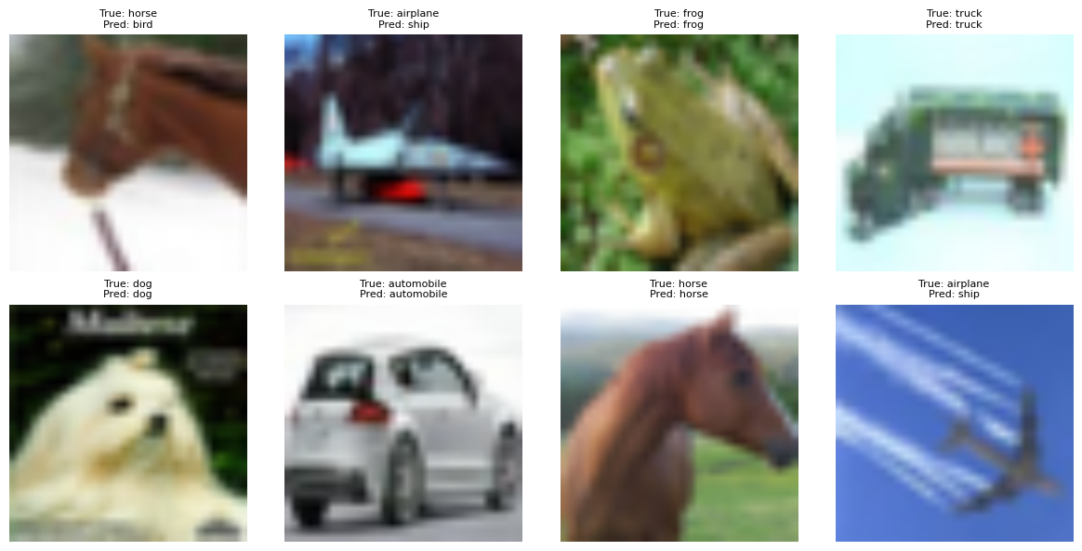
Model Visualizations

Slide 11
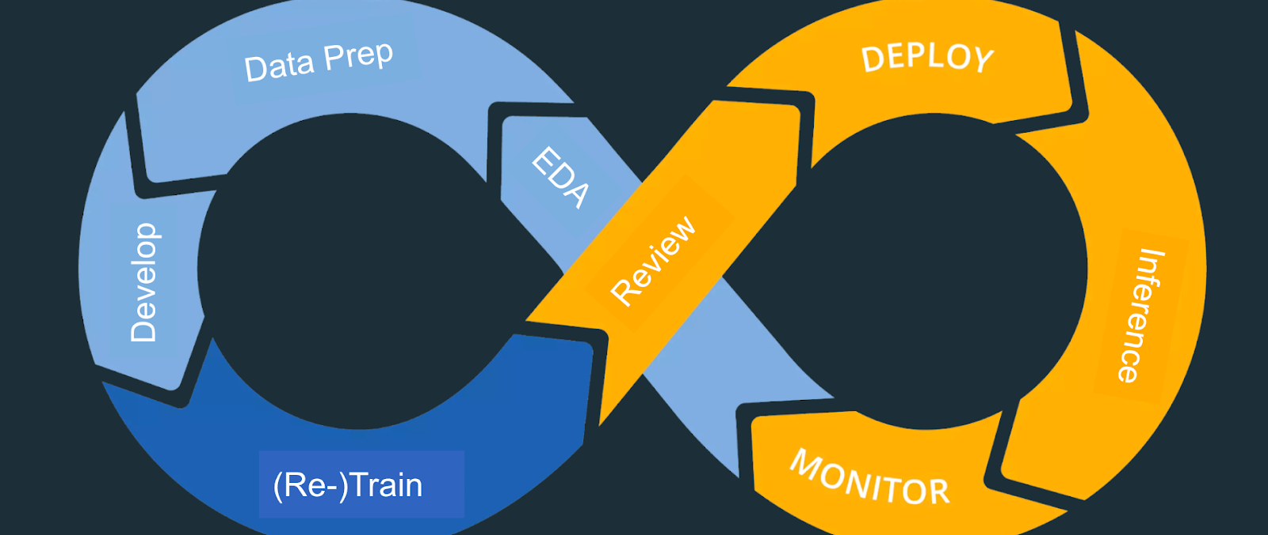
Mlops Implementation with MLflow
End-to-End Model Management & Monitoring

Slide 12
Key Components:
MLflow: Central experiment tracker
Local SQLite: Development tracking database
Custom Monitors: Production performance tracking
Azure Integration: Cloud deployment bridge

Slide 13
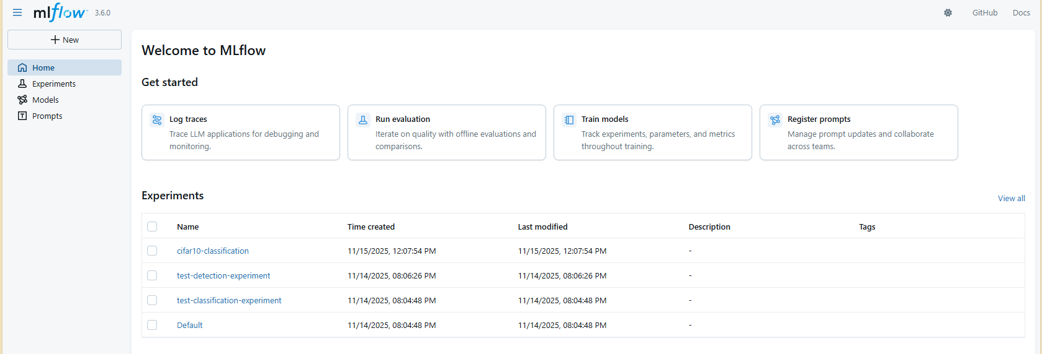
Mlflow UI Images:

Slide 14
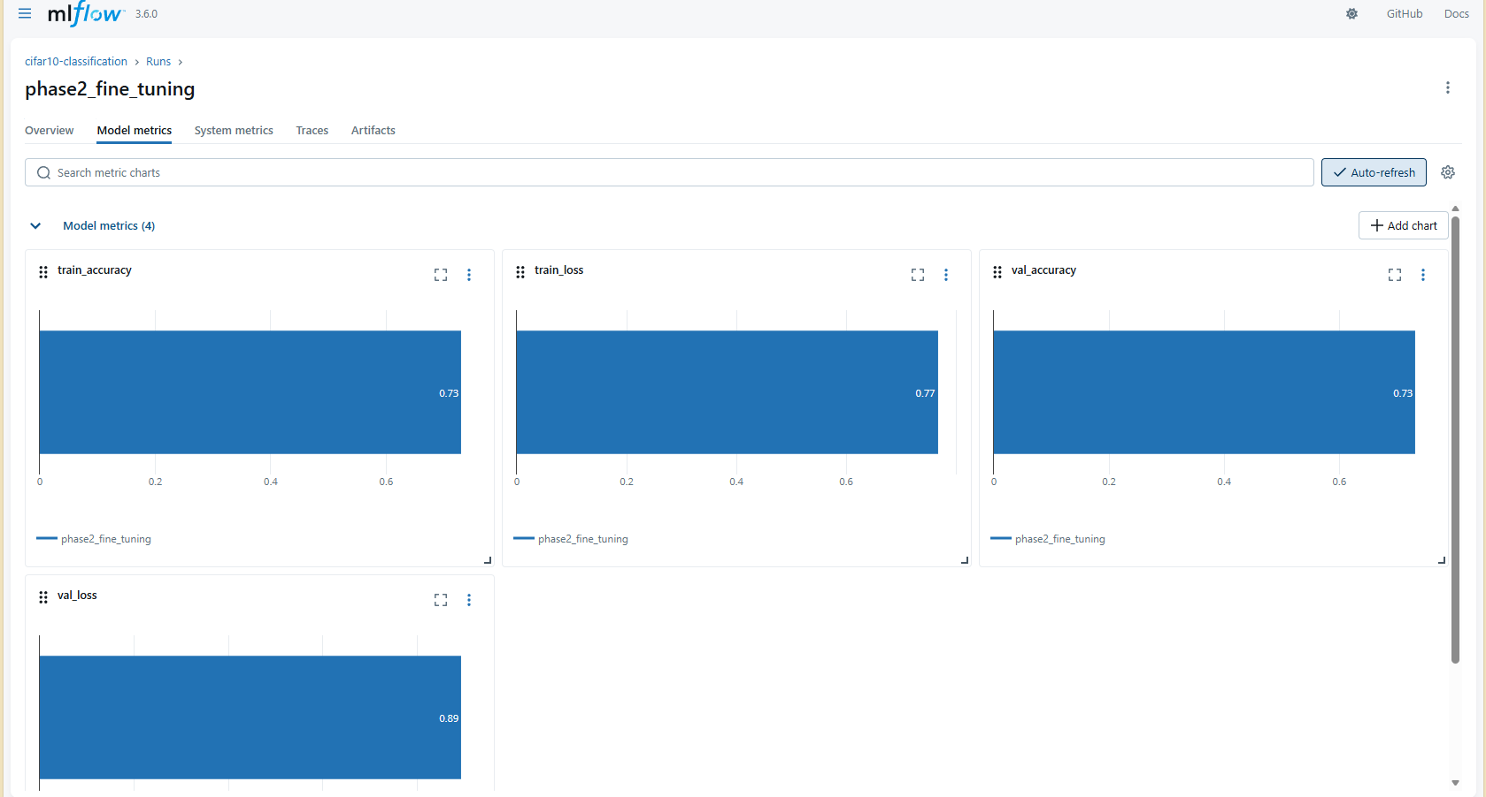
Mlflow UI Images:

Slide 15
Results & Metrics:
Classification Model Performance
1. Final Test Accuracy: 82%
2. Training Time: ~60 minutes (with MLflow tracking)
3. Model Versions: 3+ registered versions
4. Experiments Tracked: 10+ complete runs
Monitoring System
1. Prediction Tracking: Real-time with <100ms overhead
2. Alert Accuracy: 100% in testing scenarios
3. Data Collected: Parameters, metrics, artifacts, predictions
MLOps Maturity
Experimentation
Versioning
Monitoring
4. Documentation

Slide 16

Team Members:
List of Team members and tasks worked on.

Slide 17
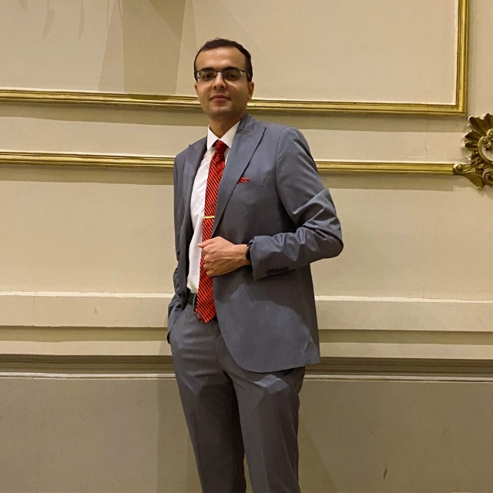
Basel Mohamed Mostafa
Worked on:
Classification Model.
Mlops & Mlflow.

Slide 18

Object Detection Model

Slide 19
Model Details:
Object Detection system using a pre-trained YOLO model (yolov12x.pt) from the Ultralytics library. The goal was to build a model capable of detecting and classifying multiple objects in images with high accuracy and fast inference speed.
Model Setup and Evaluation
to measure its performance. The evaluation automatically generated detection results and key metrics including:
mAP@0.5 – Measures the overlap quality between predicted and ground-truth bounding boxes.
mAP@0.5:0.95 – A more strict score averaged across 10 IoU thresholds.
Precision – Percentage of predicted boxes that are correct.
Recall – Percentage of actual objects successfully detected.
These metrics provide a full understanding of both accuracy and robustness of the object detection model.

Slide 20
Model Details:
Key Code Operations:
1)Load YOLO model:
model = YOLO("yolov12x.pt")
2) Run validation on COCO128:
metrics = model.val(data="coco128.yaml", imgsz=640)
3) Display sample detection results:
display(Image(filename=img_path))
4) Export structured performance report:
with open("model_evaluation_report.txt", "w") as f:
f.write(report)
]

Slide 21
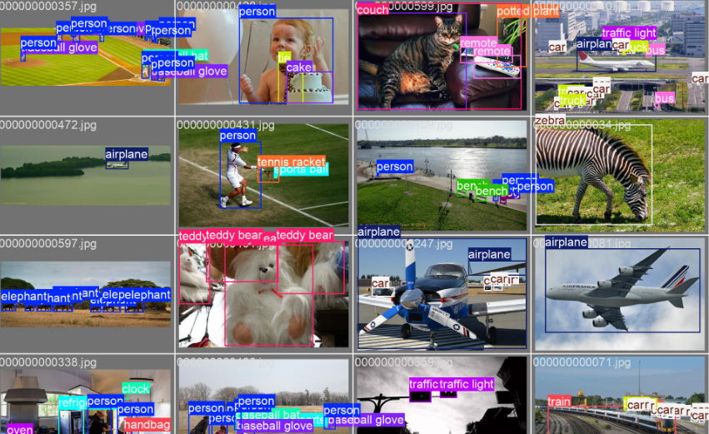
Summary
The YOLOv12x model successfully completed object detection on the validation data, generating reliable performance scores and visual outputs. The evaluation report summarizes the model’s strength in identifying objects with strong precision the project requirements for a trained and evaluated object detection system.
and recall, meeting

Slide 22

Mohamed Hamada Farghali
Worked on:
Object Detection Model.

